Slide 1
Communicating Core Competencies
Core Competency Chat for grade 8s and 9s

Slide 2
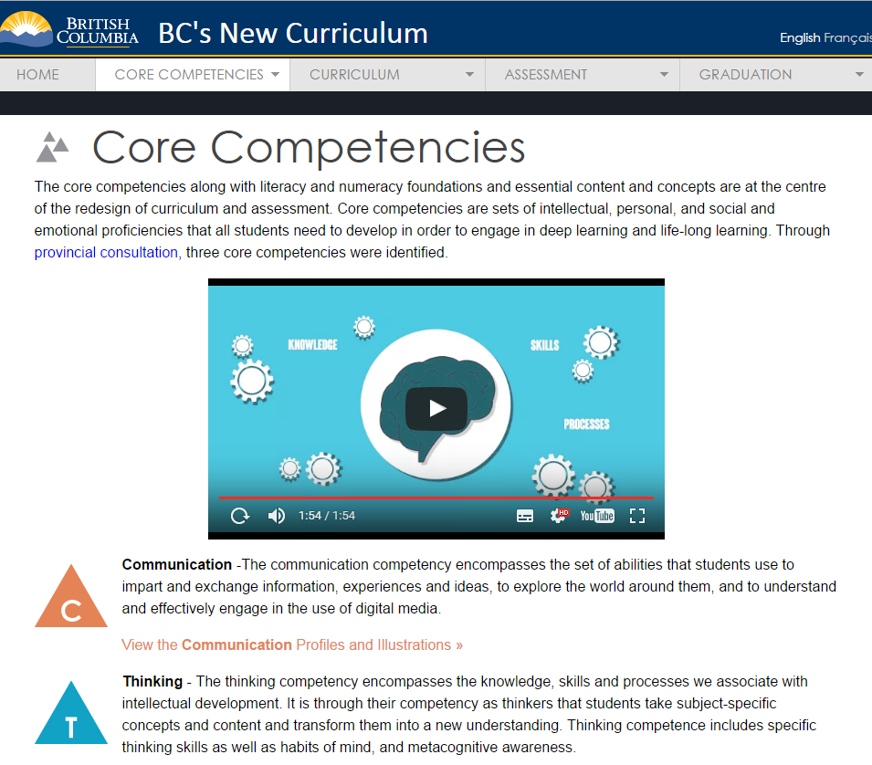
The Website:
https://curriculum.gov.bc.ca/competencies

Slide 3
What is a Core Competency?
com·pe·tence
ˈkämpədəns/
noun
noun: competency
1.
the ability to do something successfully or efficiently.
"the players displayed varying degrees of competence"
Core competencies are:
sets of
intellectual
personal, and
social and emotional abilities.
These abilities help
engage in deep learning
life-long learning
reach goals in life
synonyms: | capability, ability, competency, proficiency, accomplishment, expertise, adeptness,skill, prowess, mastery, talent

Slide 4
Core Competencies Overview
Core Competencies
Communication
Thinking
Personal and Social Responsibility
Positive Personal and Cultural Identity
Personal Awareness and Responsibility
Social Responsibility
Creative Thinking
Critical Thinking

Slide 5
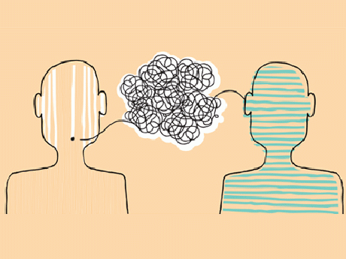
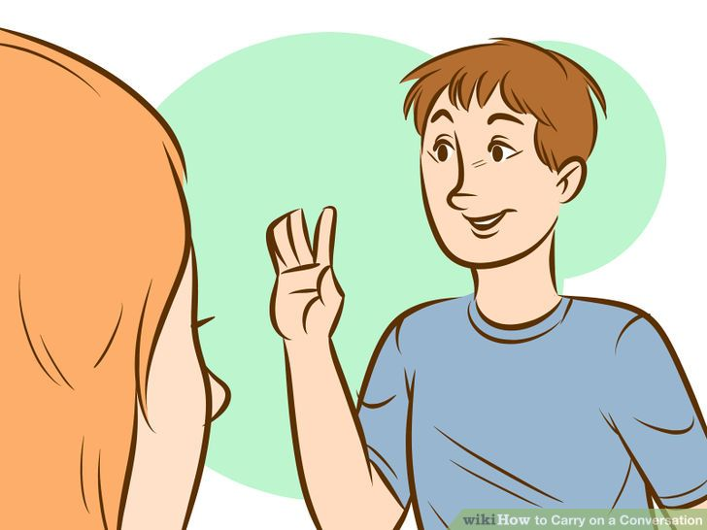
What does it look like?
Conversation led by you:
with an assigned teacher
assigned groups of 6 from your tutorial group
Chosen groups of 1, 2, or 3 students per conversation
5 minute conversation per student
Discussion:
“How have you personally developed one of the three core competencies over this year
- in your learning -
across your classes -
in and outside of school?” -

Slide 6
Countdown to Core Competency Chat
GO TO:
Tutorial for guidance and information
DECIDE:
Individual or group of two or three
REFLECT:
How do the core competencies relate to YOU?
FIND:
one competency to focus on
PRACTICE:
The interview with your peers
CHAT DAY:
MAY 17
NOW

Slide 7
More information for you and your parents:
https://www.curriculum.gov.bc.ca/
competencies
https://www.cccnorth.weebly.com

